Slide 1
Team Xtreme

Slide 2
MEMBERS
01. Project Lead
03. Documentation Lead
Zhenyang Lin
Weihao Huang
02. Tech Lead
04. Developers
Abhishek Shah
Yali Zhang
Siqing Zheng
Ao Liu
Leo Sun

Slide 3
01
APIs & Functions
01-1. Class
01-2. Pacman
01-3. Ghost
01-4. Board

Slide 4



01-1. Class
Dot class
boolean isLarge()
AStationaryElement
(abstract class)
Fruit class
Wall class
boolean isExit()
normal
exit

Slide 5



01-1. Class
Wall detection
detectCollisionWithWall(Wall wall)
Character class
Ghost detection
detectCollisionWithGhost()
AMovingElement
(abstract class)
Life - 1
Dot detection
Ghost class
detectCollisionWithDot(Dot dot)
Score +
dots disappear after being eaten
Fruit detection
detectCollisionWithFruit(Fruit fruit)
Score +
fruits disappear after being eaten

Slide 6





01-2. Pac-Man
Change direction
setVel(Point vel)
Character class
Pac-Man starts with 3 lives.
int variable life
GameStore class
Loses 1 life when colliding with a non dark blue or non-flashing ghost
detectCollisionWithGhost(Ghost ghost)
AMovingElement class
Next level if Pac-Man eats all the dots
void loadGame(int level)
GameStore class

Slide 7






01-3. Ghosts
Appear in the middle with different colors
void initializeGhosts()
GameStore class
Turn dark blue and then start flashing when Pac-Man eats large dots
int variable status change
Ghost class
Dark blue / flashing ghosts become two eyes(visor) and travel quickly to the square box in the middle of the screen when colliding with Pac-Man.
updateState(AMovingElement character, AMovingElement context)
GhostReturningStrategy class

Slide 8


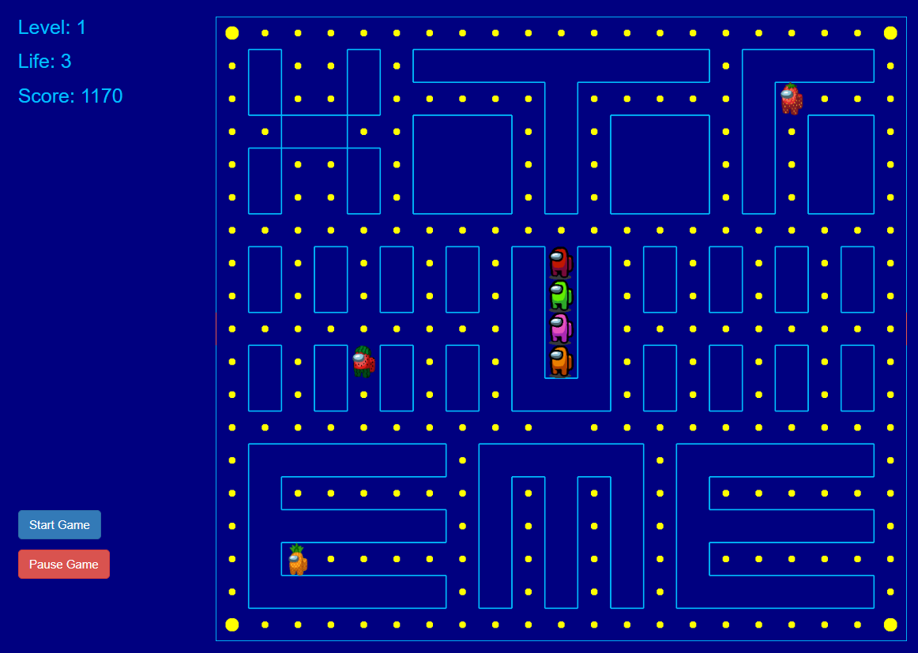

01-4. Board
gameRestart()
GameStore class
Button
Change gamePause variable in front end
Board stops updating
Different level
maps with different size and complexity stored in json files for different levels.
loses all 3 lives then show “game over”
life == 0
“Game Over” alert window
GameStore class

Slide 9

01-4. Board
240 dots and 4 blinking big dots
stored and specified in the json file we used to store the map
Fruit will periodically appear on the board
placeFruit(int type, int score)
timer % certain number == 0
place different kinds of fruit
GameStore class
The Pac-Man game is extensible
int variable level
select the level we want to play
GameStore class

Slide 10
02
UML Diagram
02-1. APaintObj
02-2. IPacManCmd
02-3. ICollisionStrategy
02-4. IUpdateStrategy
02-5. Factory
02-6. GameStore

Slide 11
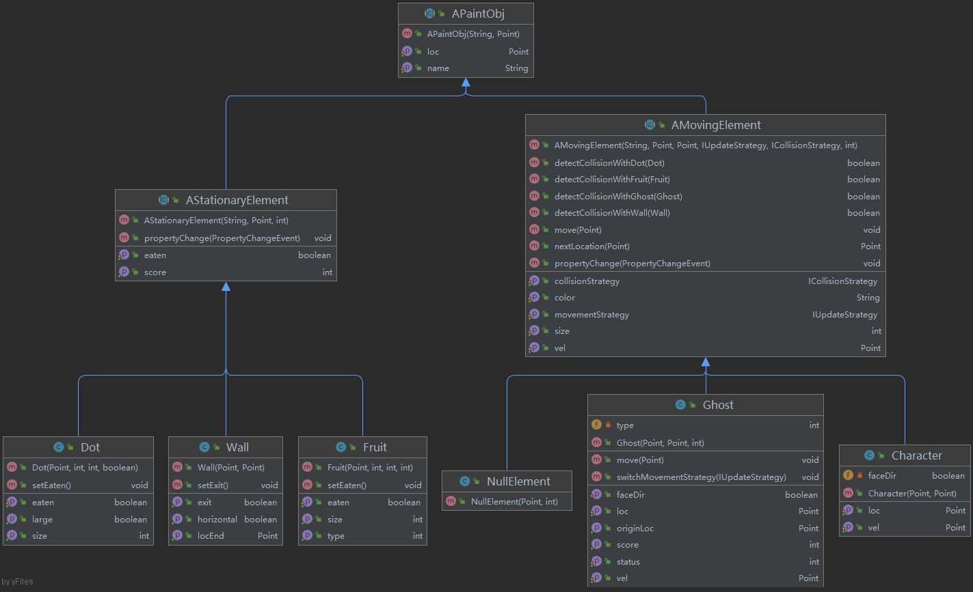
02-1. APaintObj

Slide 12
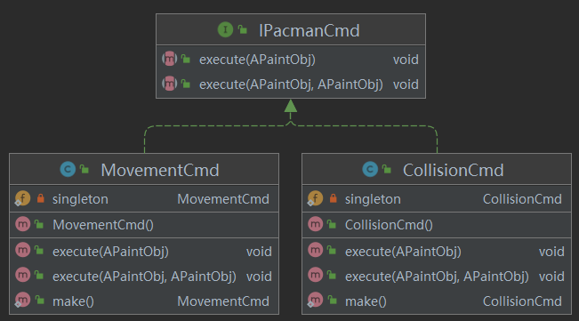
02-2. IPacmanCmd

Slide 13
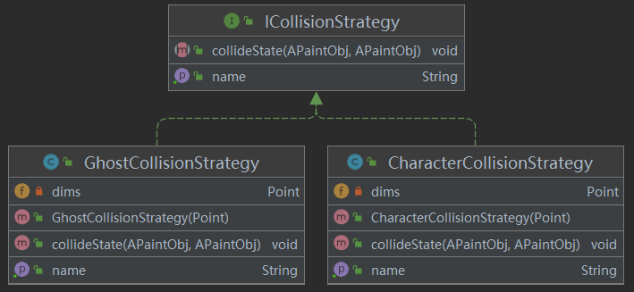
02-3. ICollisionStrategy

Slide 14
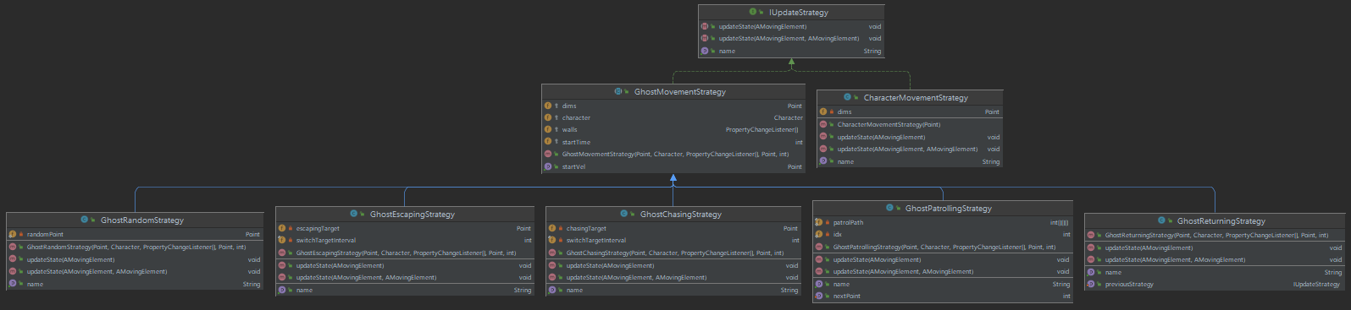
02-4. IUpdateStrategy

Slide 15
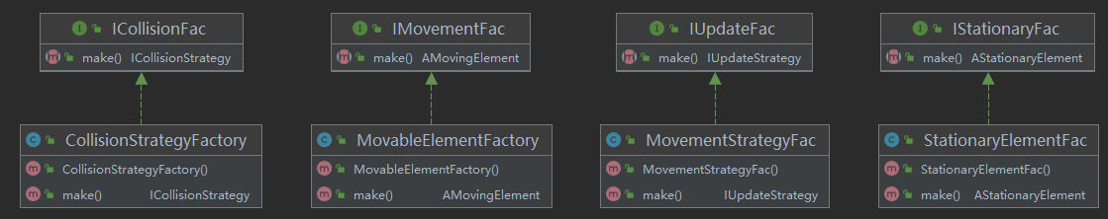
02-5. Factory

Slide 16
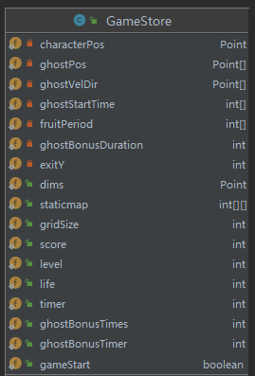
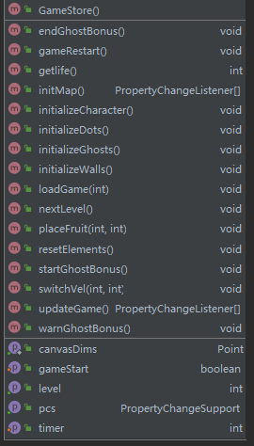
02-6. GameStore

Slide 17
03
Design Decisions

Slide 18
Design Decisions
Strategy Design Pattern
Singleton Design Pattern
Factory Design Pattern
Composite Design Pattern
Command Design Pattern

Slide 19
04
Ghost Strategies

Slide 20
04-1. Ghost Strategies
Move toward/away from Pac-Man
GhostChasingStrategy
GhostRandomStrategy
GhostPatrollingStrategy
GhostEscapingStrategy
updateState(AMovingElement character, AMovingElement context)

Slide 21
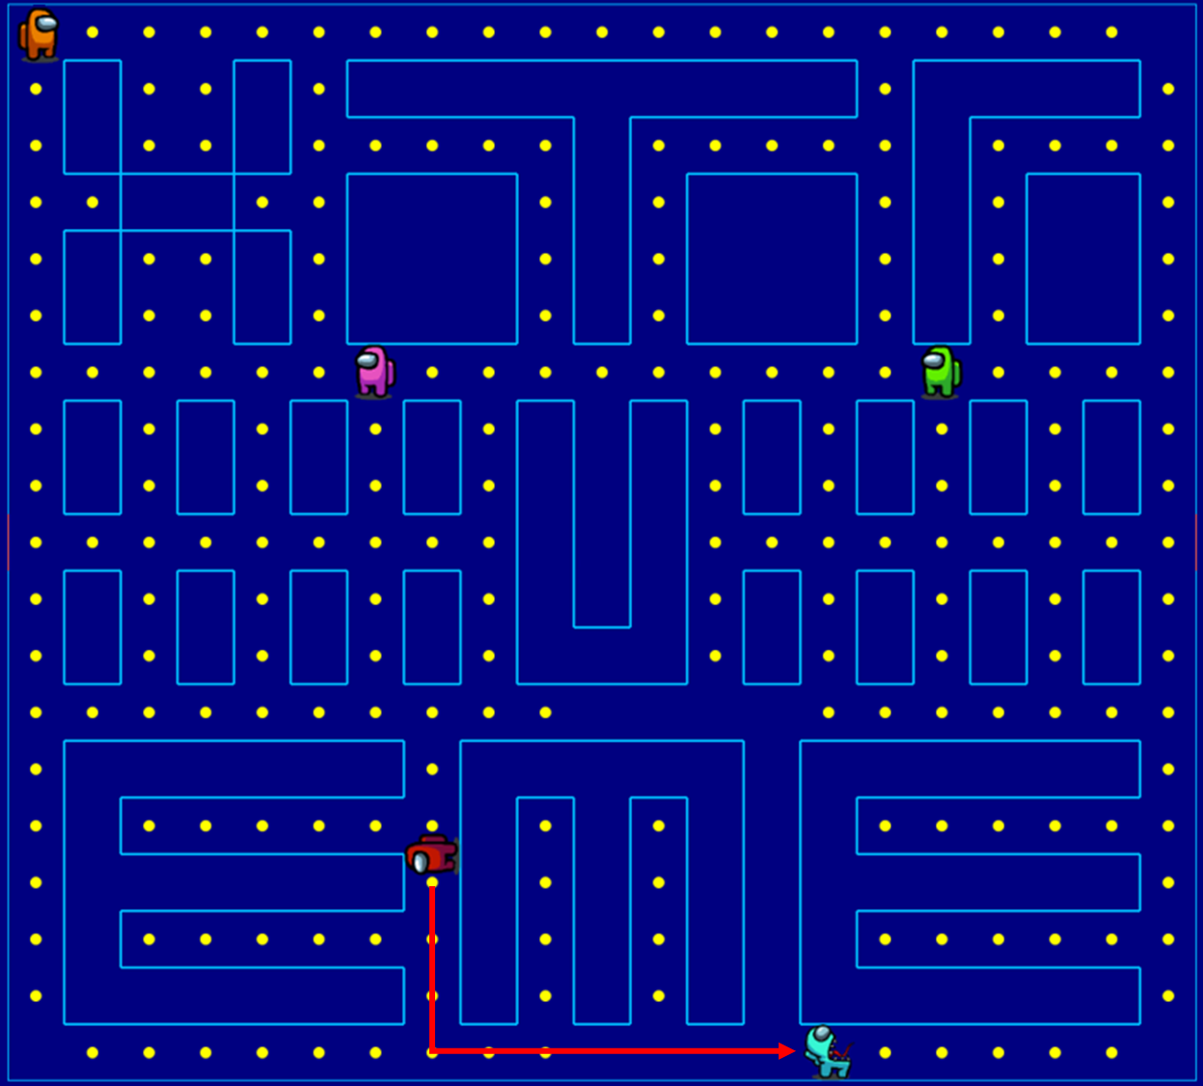
GhostChasingStrategy
Ghost chases the PacMan along the shortest path
Target point is updated as the location of PacMan every 5 seconds
After reaching the target point, move along the current direction
Change direction after hitting a wall

Slide 22
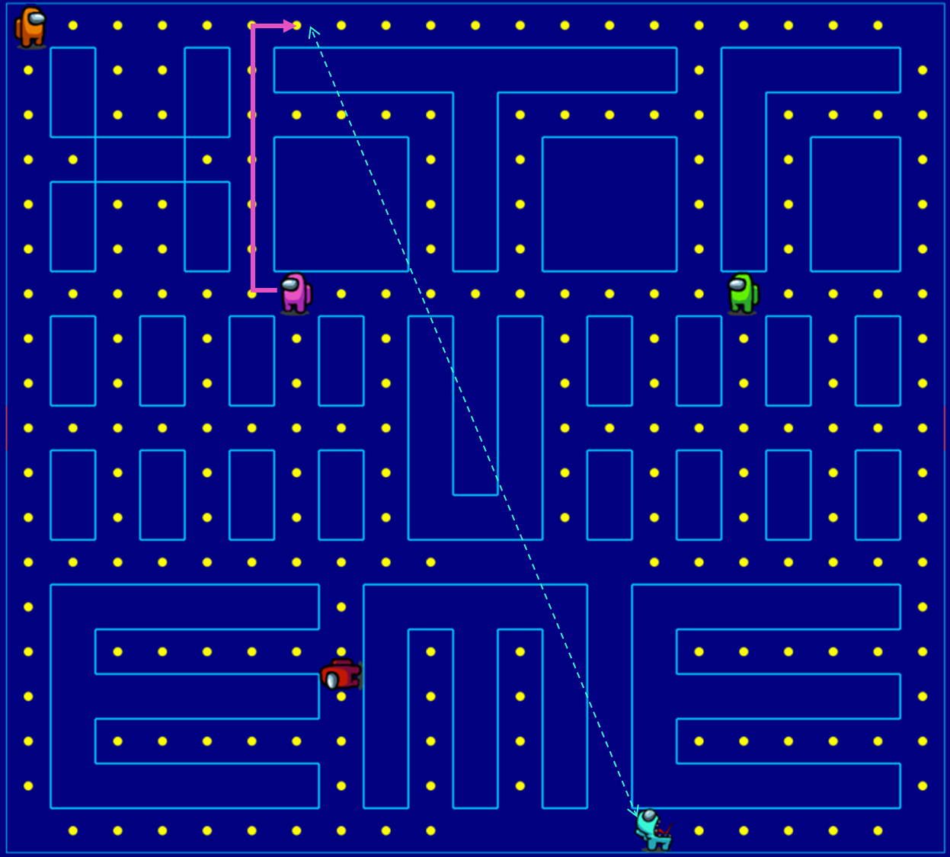
GhostEscapingStrategy
Ghost moves to a target against the PacMan along the shortest path
Target point is updated as the mirror point of the PacMan every 2 seconds
If target point is inside walls, find an empty point nearby

Slide 23
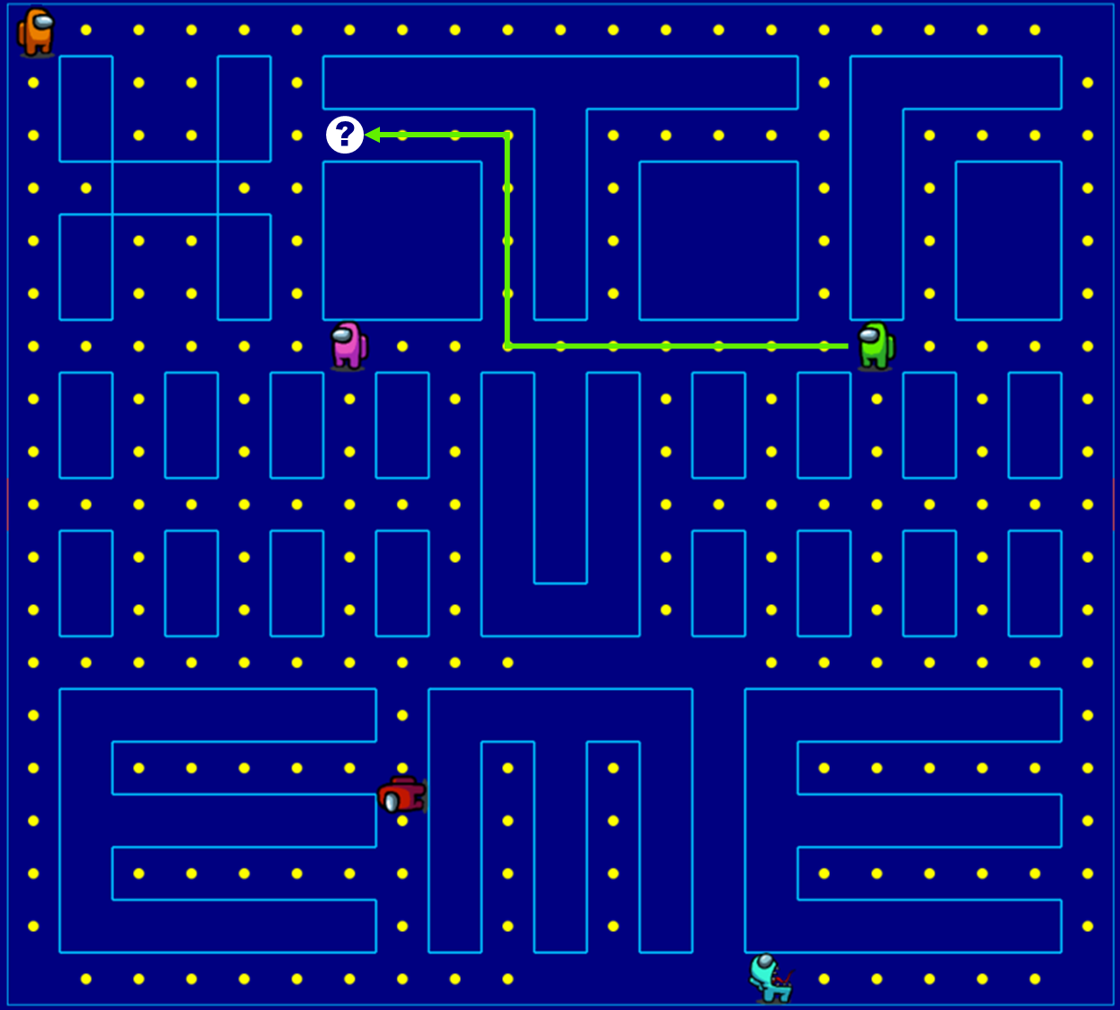
GhostRandomStrategy
Ghost moves to a random target along shortest path
Target point is updated randomly once reached

Slide 24
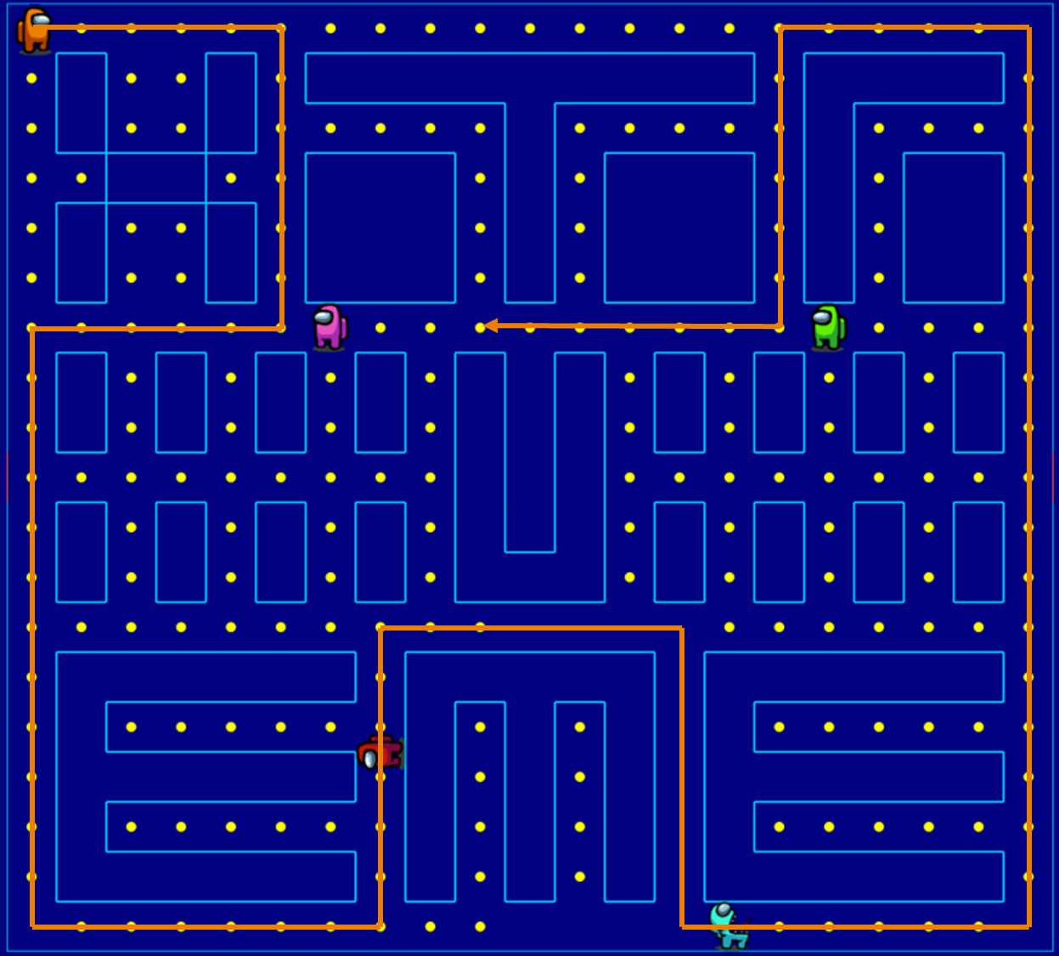
GhostPatrollingStrategy
Ghost moves through a given path
Once finished, move back to the starting point and continue

Slide 25
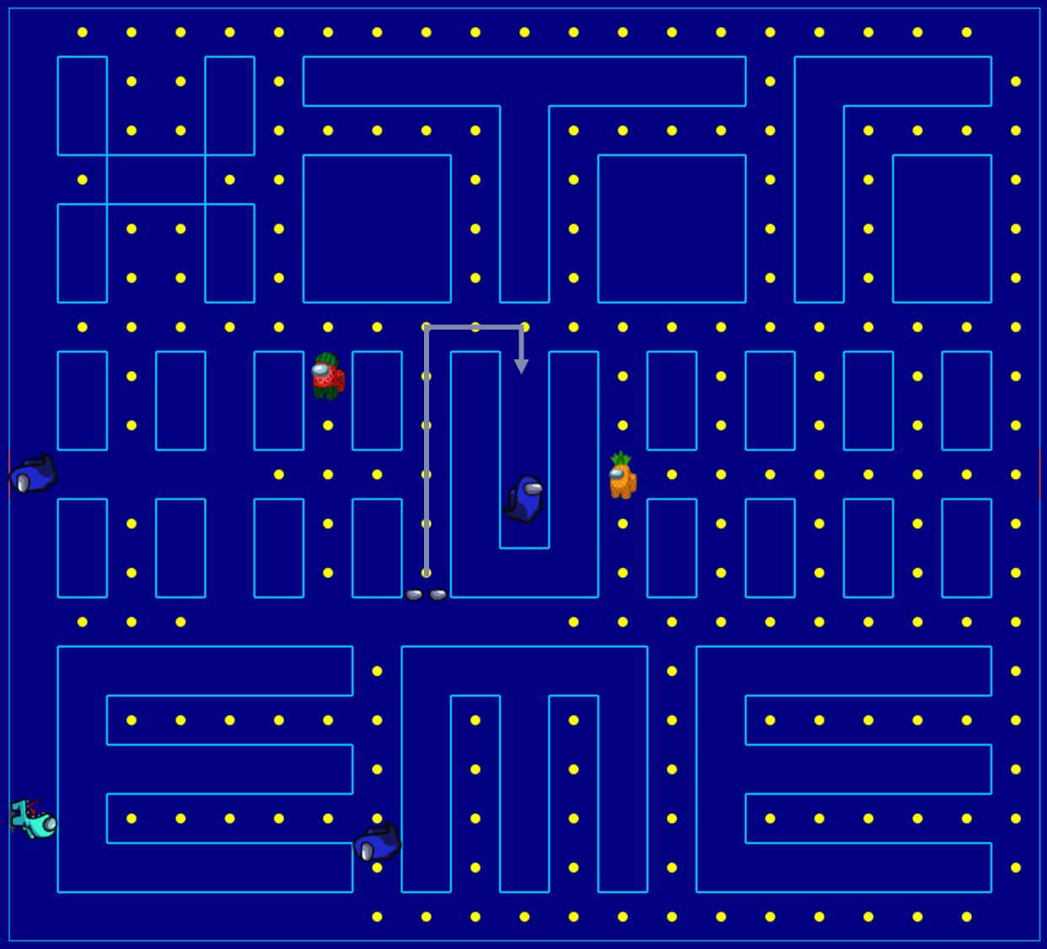
GhostReturningStrategy
Ghost moves back to the middle box after becoming two eyes

Slide 26
05
Demo

Slide 27
THANK YOU

